Slide 1



ABAP on Hana s/4 Hana Training
Day 7
contact@anubhavtrainings.com

Slide 2

Agenda – Day 7
Calculation View
Implementing OIA Using Calculation View

Slide 3
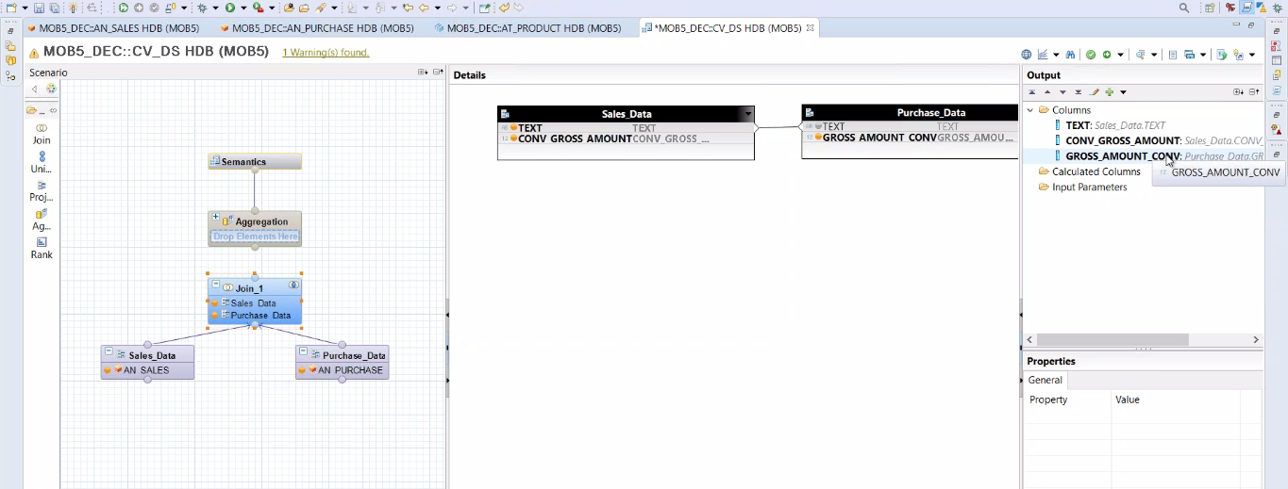
Calculation View
Calculation views provide a way to do flexible, complex logic in the database. They are built on top of one or more analytic or attribute views and allow you to do calculations after aggregation and grouping. Calculations are generally done after grouping at the attribute level and after aggregation at the analytic level.

Slide 4

OIA Scenario Using Calculation View
Mr. James told about me to the CIO of the company last week on Christmas dinner. The CIO is very impressed by listening my stories how I helped Mr. James. Now he want me to help him as well.
He called me for a 1:1 meeting this morning. He was a secret task by the CEO of the co. Since quite a long time there were multiple escalations going on in co. for unpaid bills to their vendors and also customers who are unhappy due to unavailability of stocks.

Slide 5

End of Day 7
Trainer: Anubhav Oberoy & Shubham Singh

Slide 6

Trainer: Anubhav Oberoy & Shubham Singh

Slide 7
THANK YOU
If you cannot do
great things, do small things in a great way.
Anubhav Oberoy & Shubham Singh
https://www.anubhavtrainings.com

Slide 8


We’re committed to empower you to be
Most Desirable Resource
through powerful training solutions.
We build the workforce of the future.
250+
Corporate Clients
30,000+
Learners Trained
25000+
Learners Placed
FREE WEBINARS
Sign up for free webinars with industry experts every fortnight!
Enroll Now!
Contact us today!
https://anubhavtrainings.com/

Slide 9




More from AnubhavTrainings.com

